Slide 1
Lifecycle hooks in class component and functional component
Salman Ahmed G

Slide 2
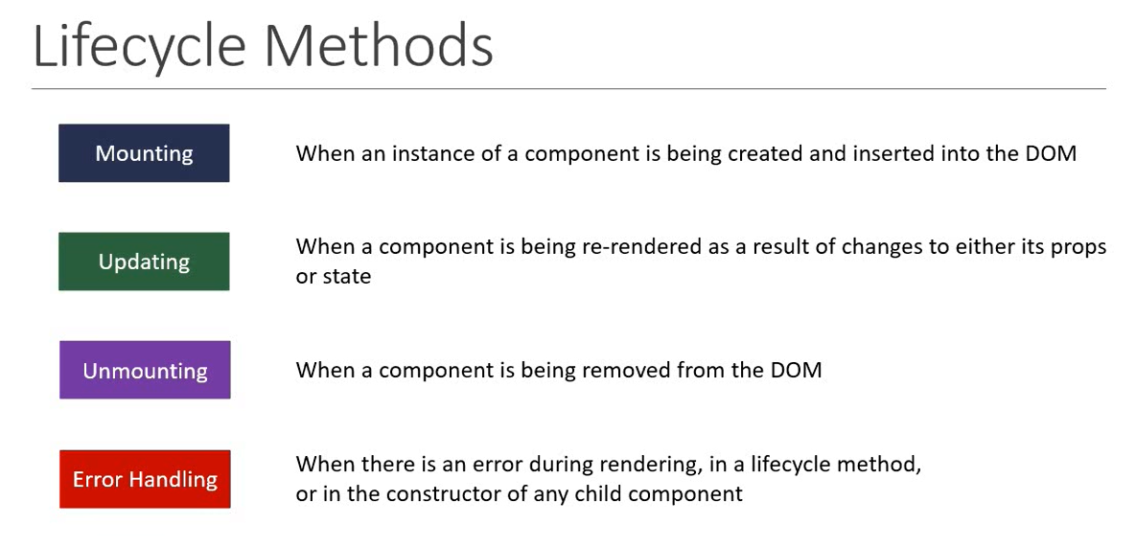
Lifecycle methods

Slide 3
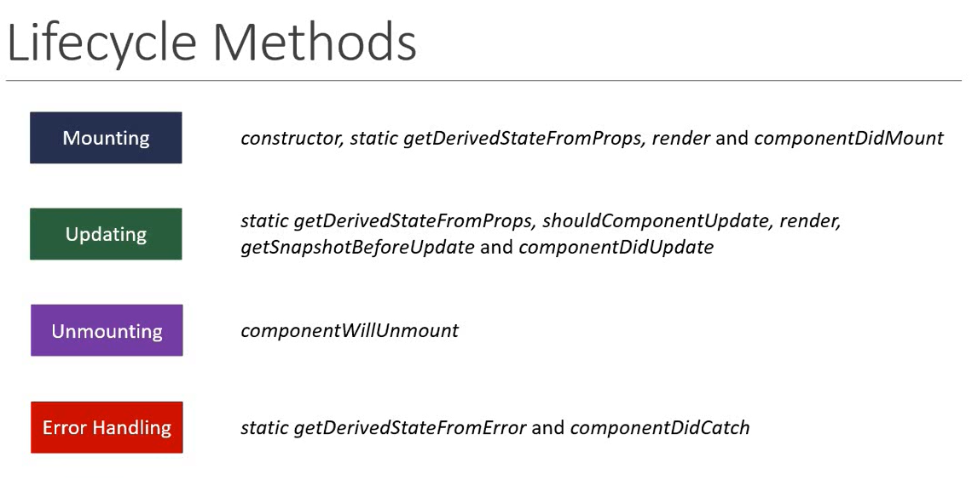
Lifecycle methods

Slide 4
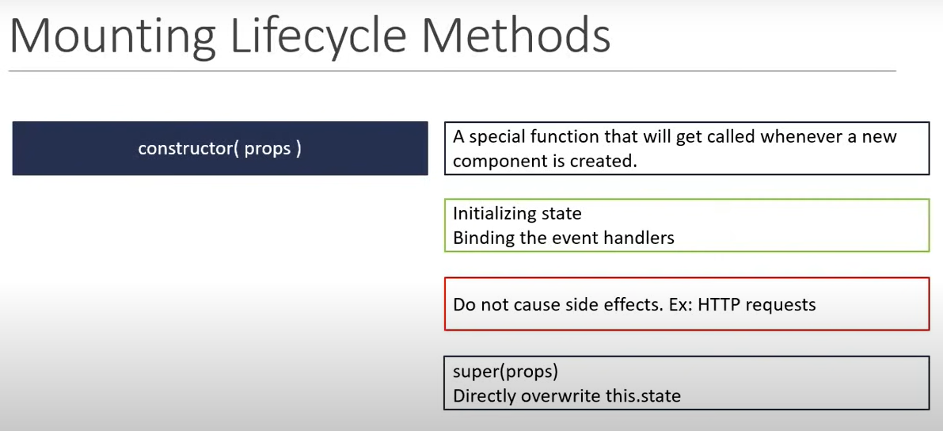
Mounting lifecycle

Slide 5
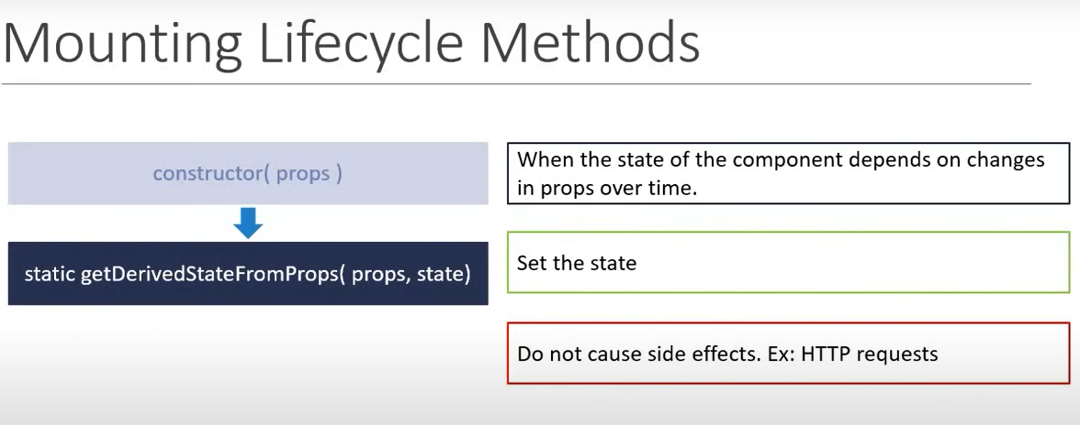
Mounting lifecycle

Slide 6
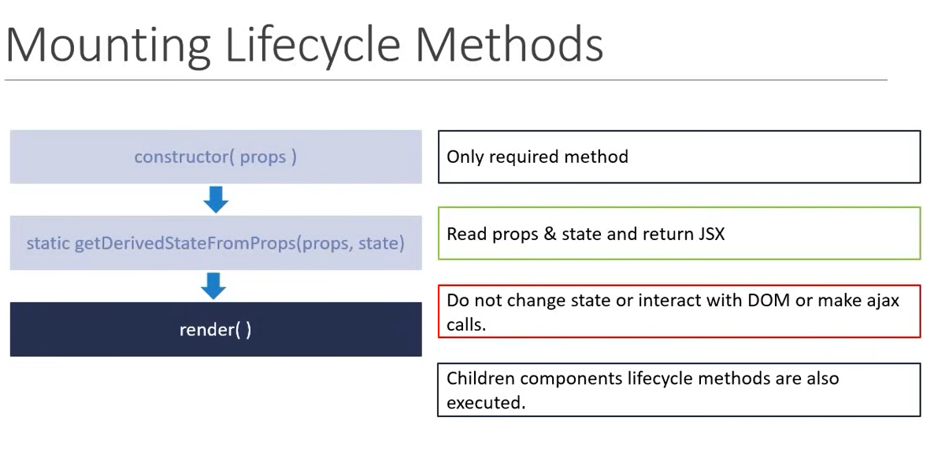
Mounting lifecycle

Slide 7
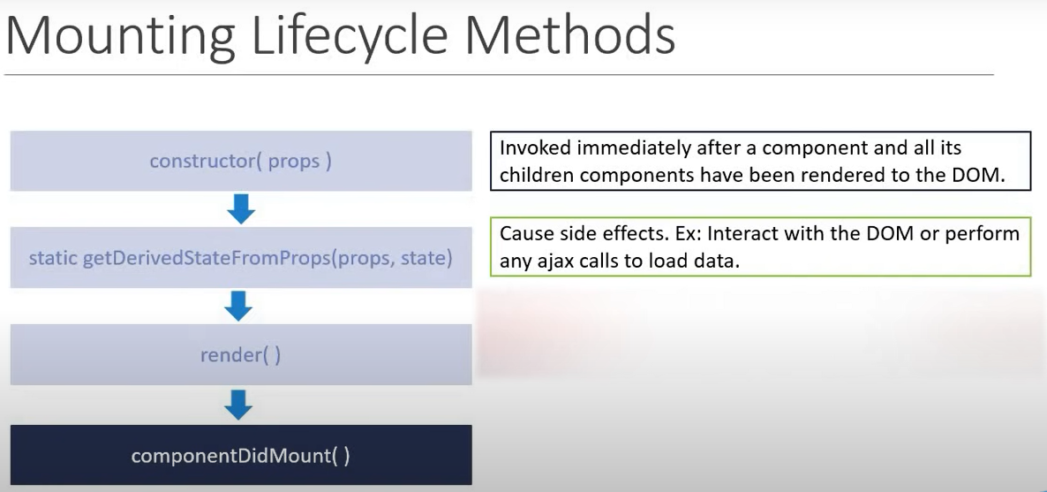
Mounting cycle

Slide 8
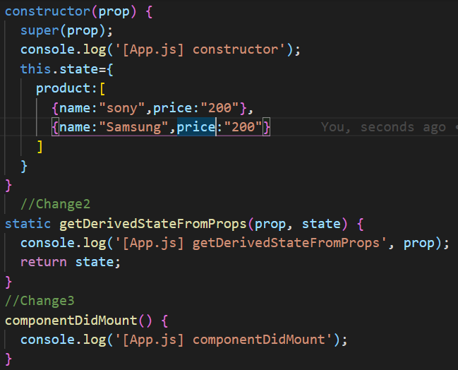
example

Slide 9
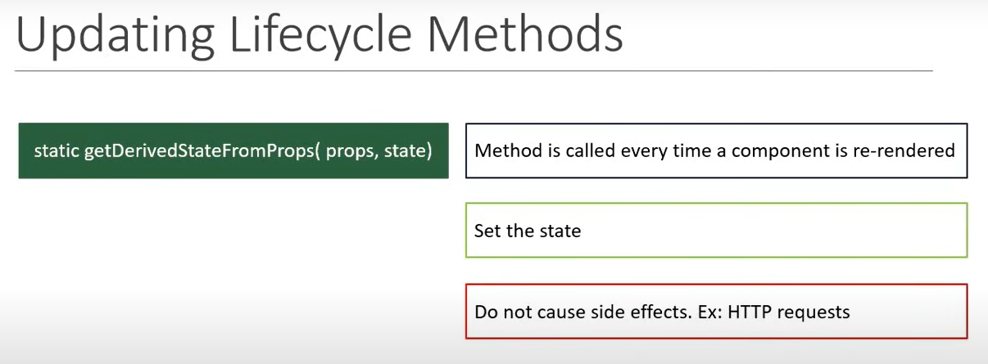
Updating lifecycle

Slide 10
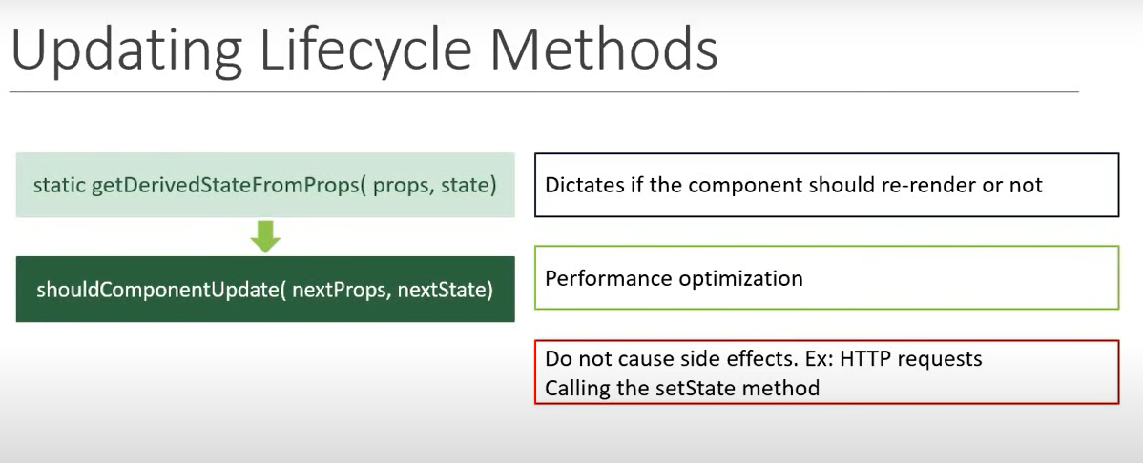
Updating lifecycle

Slide 11
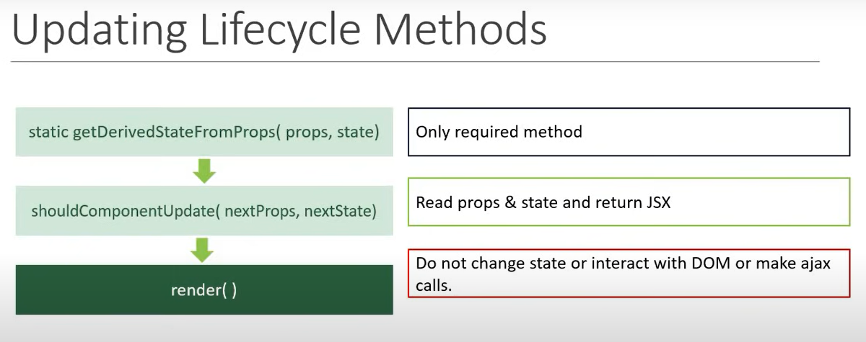
Updating lifecycle

Slide 12
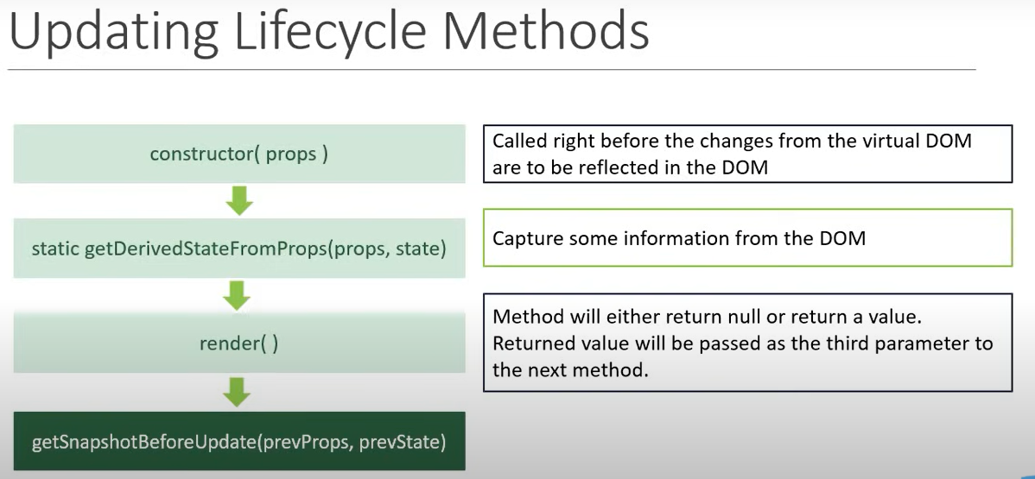
Updating lifecycle

Slide 13
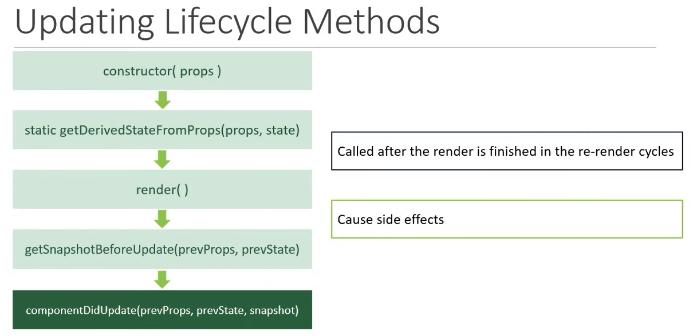
Updating lifecycle

Slide 14
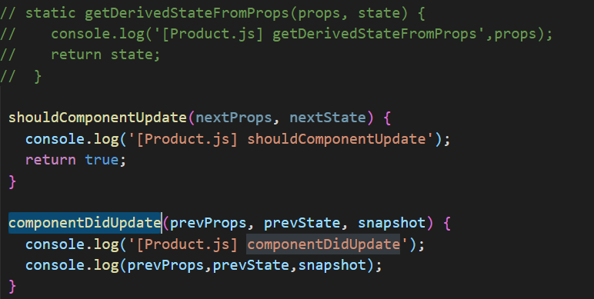
example

Slide 15
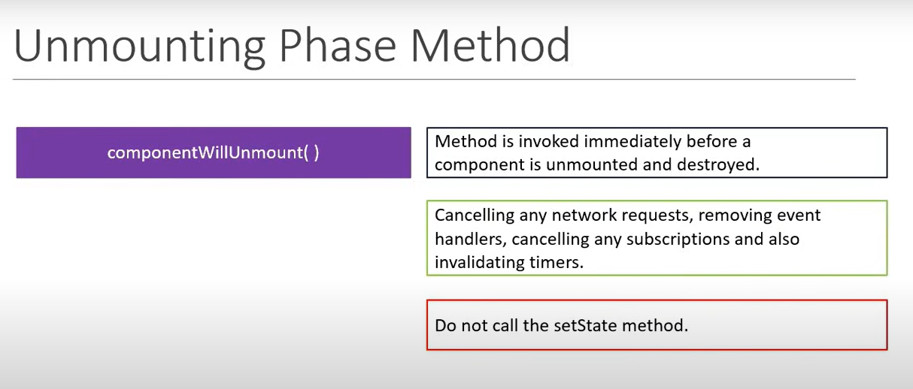
Unmounting lifecycle

Slide 16
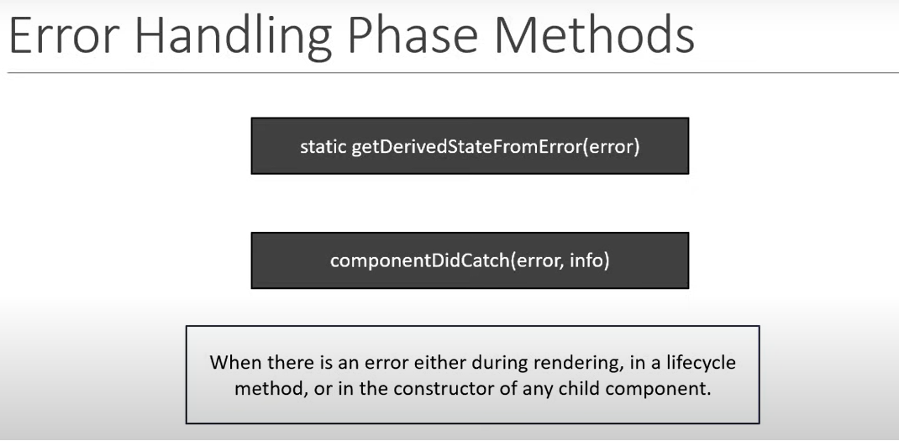
Error handling

Slide 17
Useeffect in functional component
The Effect Hooks lets you perform side effects in functional components.
It is a close replacementfor componentDidMount,componentDidUpdate,componentWillUnmount.

Slide 18
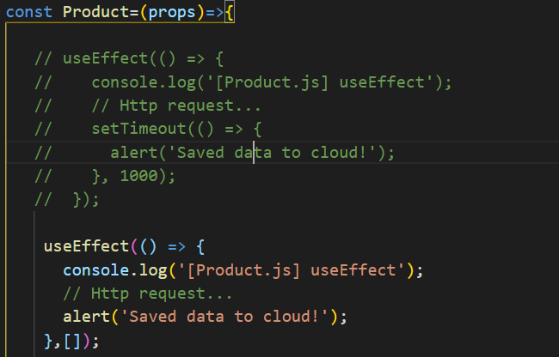
example

Slide 19
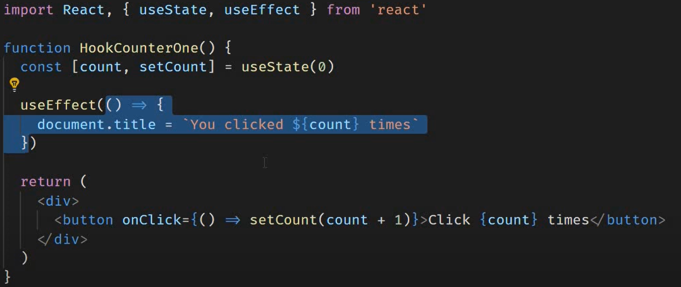
Run After every render

Slide 20
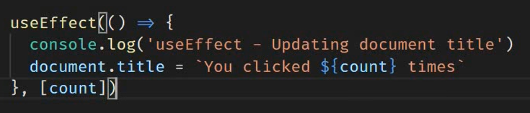
Run conditionally

Slide 21
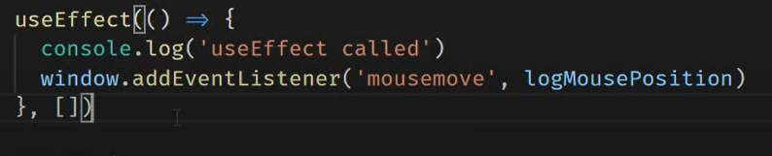
Run only once

Slide 22
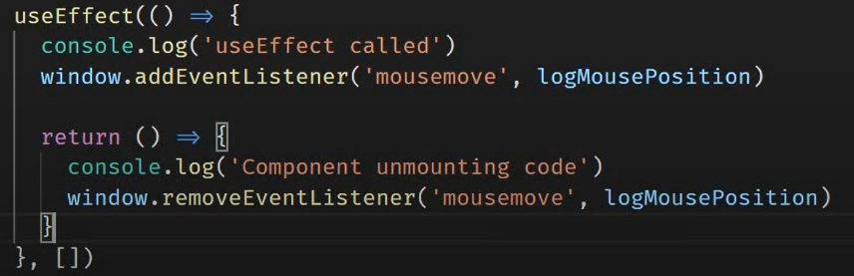
Useeffect clean up

Slide 23
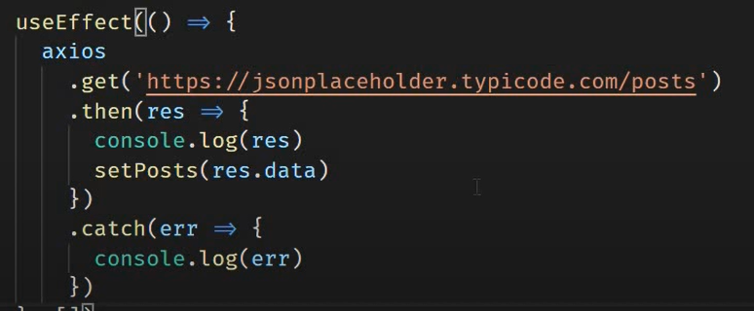
Useeffects fetch data

